Slide 1
CTC
Parent Orientation

Slide 2
HOURS OF OPERATION
7 a.m. – 3 p.m.
Doors open for students at 7:45 a.m.

Slide 3
DAILY SCHEDULE
Half Day Programs
Half-Day Programs (AM) 8:05 a.m. – 10:40 a.m.
  Bus drop off at bottom of the hill
  Bus pick up at bottom of the hill (mid-day pick up)
  Parent drop off and pick up at top of the hill
  Student drivers enter and exit at the top of the hill
Half-Day Programs (PM) 11:35 a.m. – 2:10 p.m.
  Bus drop off at top of the hill
  Bus pick up at bottom of the hill (end of day)
  Parent drop off and pick up at top of the hill
  Student drivers enter and exit at top of the hill

Slide 4
DAILY SCHEDULE
Full Day Programs
Full Day Programs 8:05 a.m. – 2:10 p.m.
  Bus drop off at bottom of the hill
  Bus pick up at bottom of the hill
  Parent drop off and pick up at top of the hill
  Student drivers enter and exit at the top of the hill

Slide 5
LCCTC COVID-19 Guidelines
Students are to do a self-assessment each morning prior to arrival
  A self-assessment checklist is available on the school’s website (LCCTC.edu)
Face coverings are mandatory at all times
  Medical documentation is required on the 1st day of school if a student is unable to wear a face covering
  Students will be sent home if they arrive without a face covering or medical documentation stating they are unable to wear a face covering

Slide 6
LCCTC COVID-19 Guidelines
Students who refuse to wear a face covering (without medical documentation) will be subject to the progressive discipline policy for infractions
Transportation will be provided from the home school to the CTC and from the CTC to the homeschool each day
All full-day students will be able to eat at the CTC (packed lunch or cafeteria items)

Slide 7
LCCTC COVID-19 Guidelines
Students should arrive at the CTC in their program uniform
  Locker rooms will largely be unavailable due to social distancing concerns
Hats will be permitted only while using the brim for a plastic face shield
  The CTC has purchased face shields that may be used by students in addition to a face covering. They fit on the brim of a hat.

Slide 8
LCCTC COVID-19 Guidelines
Program Dismissal Times by Home District
  Annville-Cleona – 1:50 pm
  Cornwall-Lebanon – 2:00 pm
  ELCO – 1:55 pm
  Lebanon – 2:05 pm
  Northern Lebanon – 1:45 pm
  Palmyra – 1:55 pm

Slide 9
Contract Physical Education
Not all students are required to take PE
Check with sending school counselor if you are uncertain
Forms distributed during the first full week of school
Must be handed in by due dates in instruction sheet (Quarterly)

Slide 10
CTC IMPORTANT DATES
TBD - Certificate and Awards Ceremony
Students are expected to be in attendance for all CTC school days.
Transportation issues—contact sending school principal

Slide 11
BlackBoard Messages
Automatic e-mail/call system – Do not opt out of calls
  Absences and tardies
  School delays and closings
  Any other emergencies
  Customized messages
    NOCTI testing reminders

Slide 12
Counseling Services
School Counselors:
  Mrs. Flowers
    Cedar Crest
    ELCO
    Palmyra
    All non-public and out of county schools
  Mrs. Yingst
    Annville-Cleona
    Lebanon
    Northern Lebanon

Slide 13
Counseling Services
Services
  Personal/Peer Issues
  Attendance Issues
  Post Secondary Planning
  Career Counseling
  Scholarships

Slide 14
National Technical Honor Society
Criteria
  Outlined in Student Handbook
Benefits
  Scholarship Opportunities
  Leadership
  Honor Student Achievement
  Promote Educational Excellence
  Enhance Career Opportunities

Slide 15
Safe2Say Something
Statewide anonymous reporting system implemented in January.
Provides students with a way to “say something” if they are concerned about another student in school.
24/7/365
Tips can be made through the app, website, or by telephone
Tips are triaged by a Crisis Center and sent to Law Enforcement or the school to act upon.

Slide 16
CTSO
Pennsylvania coordinates eight student organizations that provide career awareness, leadership, motivation, and recognition for career related skills. The career and technical student organizations (CTSOs) are an extension of the classroom instructional program by integrating academics and career and technical skills into real work experiences.

Slide 17
CTSOs at the CTC
SkillsUSA – Vocational Industrial Clubs of America
HOSA – Health Occupations Students of America
LCBA Student Chapter – Lebanon County/PA Builders Association Youth Organization

Slide 18
Social Media & the CTC
Yes, we’re online!
  Website: www.lcctc.edu
  Facebook: www.facebook.com/lcctc
  Twitter: www.twitter.com/lcctc
Photo Release Form

Slide 19
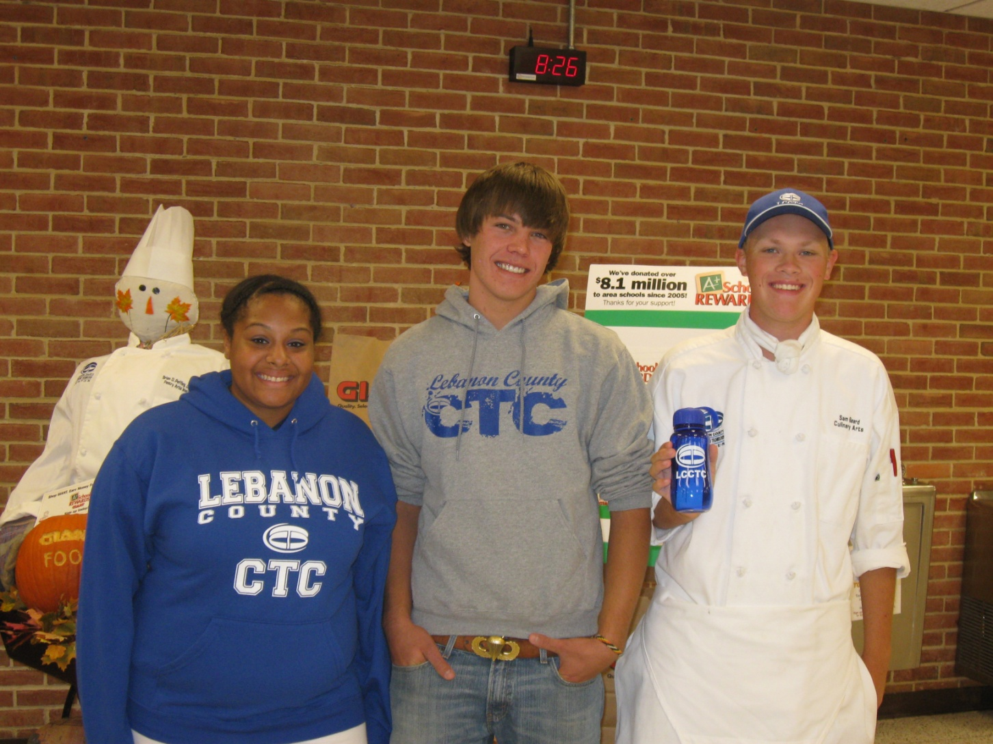
Spirit Wear

Slide 20
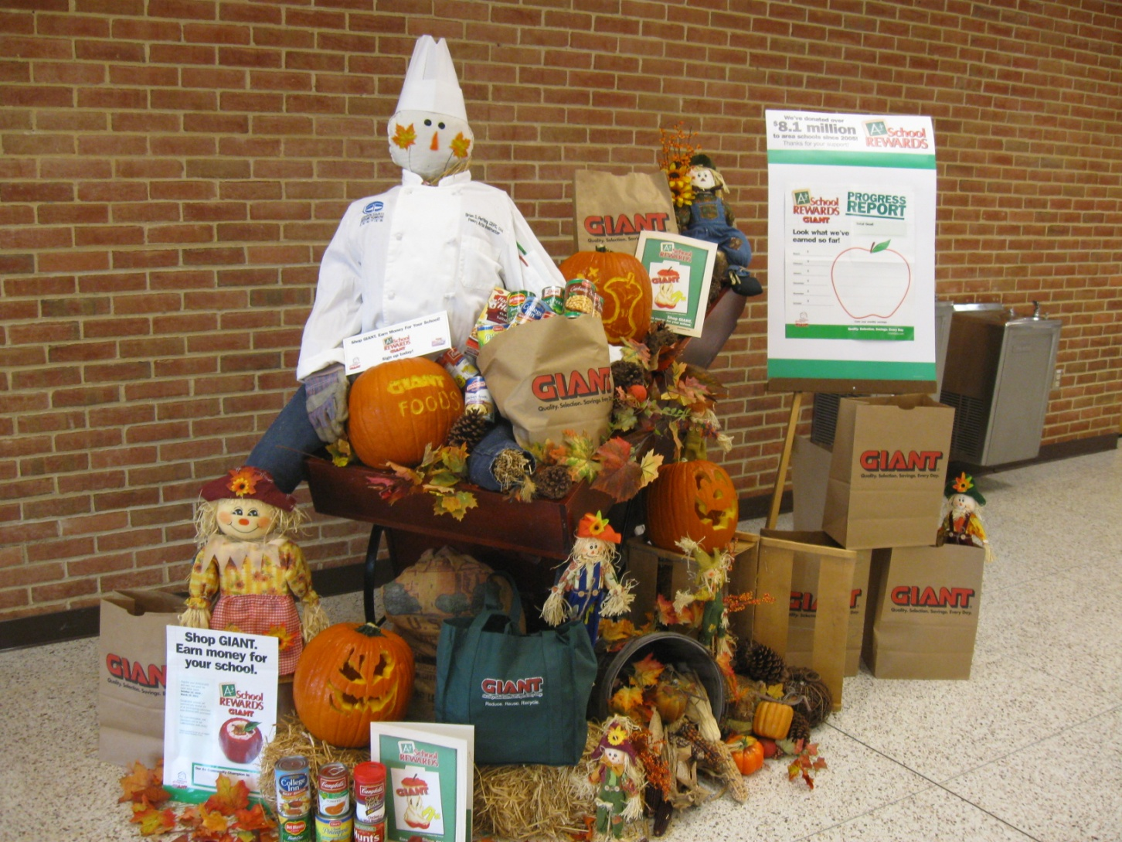
Giant A+ School Rewards Program

